Slide 1
RANDOMIZED RUMOR SPREADING
- A beautiful visualization of randomized algorithms
Project by:
Ankur Kumar - 210152
Havi Bohra - 210429
Keshav Raj Gupta – 210508

Slide 2
Problem Definition
Given a network of n nodes (or players)on a complete graph, efficiently spread a piece of information (a rumor) from a single initial source node to all other nodes using minimal number of rounds and communication overhead.

Slide 3
What are the uses?
Computer graphics
Pattern recognition
Robotics
Geographic information system

Slide 4
Baseline Algorithm
Idea : We first propose two simple approaches:
Push Algorithm: In this algorithm, only informed players actively seek others to pass on the rumor.

Slide 5
Baseline Algorithm
Push Algorithm:
Uninformed nodes
All nodes are informed about the rumor!
Informed nodes

Slide 6
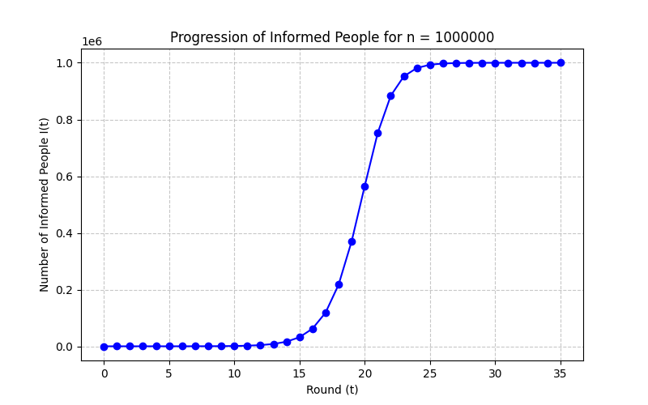
Push algorithm sample progression

Slide 7
Baseline Algorithm
Idea : We first propose two simple approaches:
Pull Algorithm: In this algorithm, only uninformed players actively seek others to ask about the rumor, hoping to select an informed person.

Slide 8
Baseline Algorithm
Pull Algorithm:
Uninformed nodes
Informed nodes

Slide 9
Baseline Algorithm
These uninformed nodes selected a uninformed node, hence no transfer of rumor
Pull Algorithm:
These nodes asked an informed node and hence will “pull” the rumor from them and become informed themselves
Uninformed nodes
All nodes are informed about the rumor!
Informed nodes

Slide 10
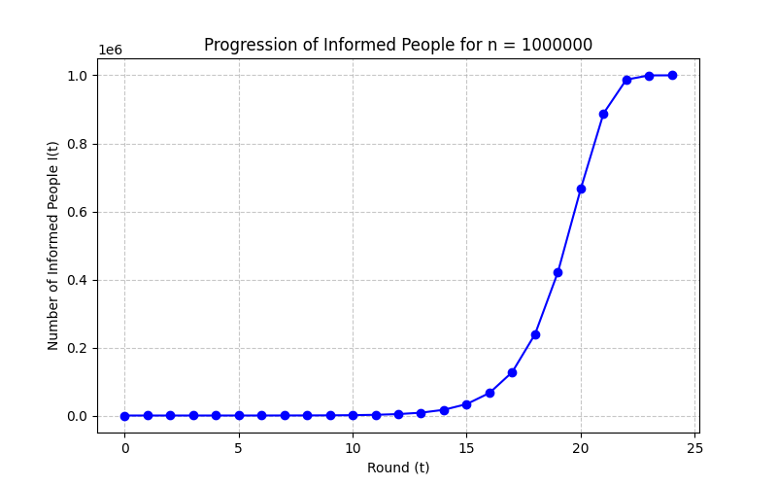
Pull algorithm sample progression

Slide 11
Some useful Lemmas
Lemma 1 (Push Algorithm - Early Phase Growth): In the early rounds (when |I_{t}|≪n), the expected number of informed players approximately doubles in each round.
Specifically E[i_{t+1}|I_{t}] ≈ 2i_{t}.

Slide 12

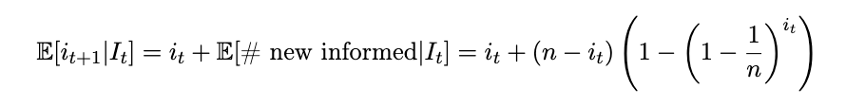


Some useful Lemmas
Proof:
Let I_{t} be the set of informed nodes at the start of round t, with i_{t} = |I_{t}|. Consider an uninformed node v ∈ U_{t}. Then:
The total expected number of informed nodes at the start of round t + 1 is:
when i_{t}≪n
We can neglect the latter term wrt 2i_{t} (e.g till i_{t} < n/2)
Therefore, E[i_{t}+1|It] ≈ 2i_{t}. This shows the expected doubling behavior in the early phase.

Slide 13
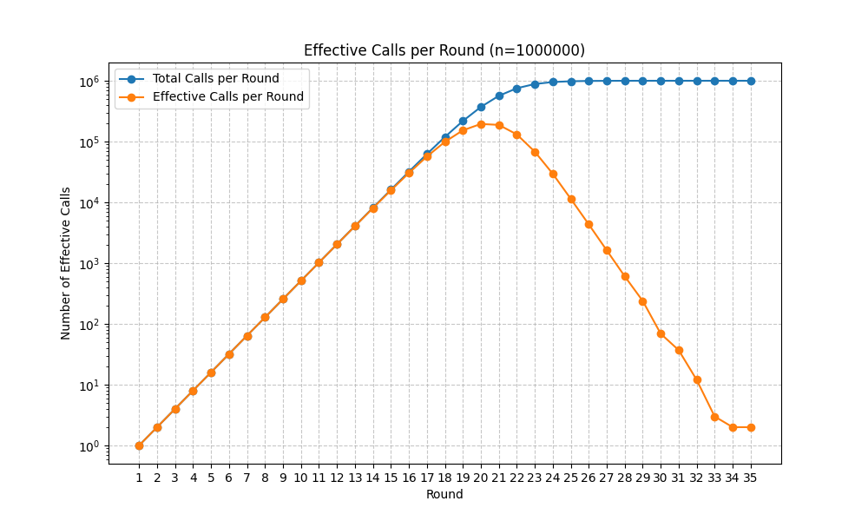
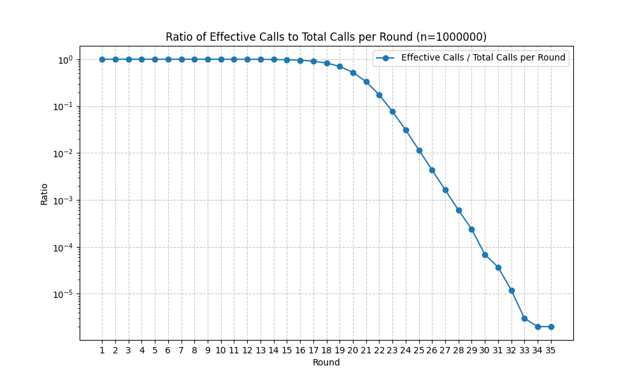
Effective calls (push) in a sample run

Slide 14
Some useful Lemmas
Lemma 2 (Pull Algorithm - Late Phase):
Let x_{t} = u_{t}/n be the fraction of uninformed nodes at the start of round t. When x_{t} is small, the expected fraction of uninformed nodes in the next round decreases quadratically.
Specifically, E[x_{t+1}|x_{t}] = x_{t}² .

Slide 15


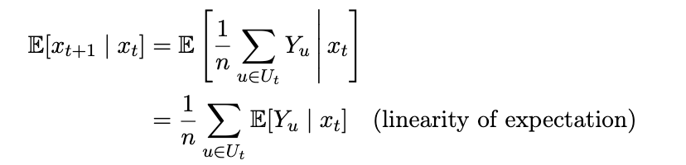
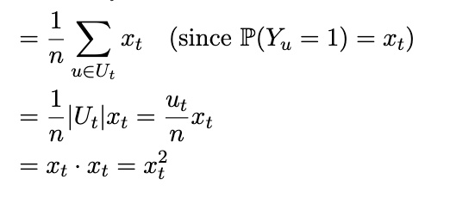
Some useful Lemmas
Proof:
Consider a single node u ∈ U_{t}. In round t of the Pull algorithm, node u contacts a node v chosen randomly uniformly from n. Node u remains uninformed if and only if v is also uninformed (v ∈ U_{t}).
Let Y_{u} be a r.v. where Y_{u} = 1 if u remains uninformed, and Y_{u} = 0 otherwise. We have P (Y_{u} = 1) = x_{t}.
Thus,
The expected fraction of uninformed nodes decreases quadratically.

Slide 16
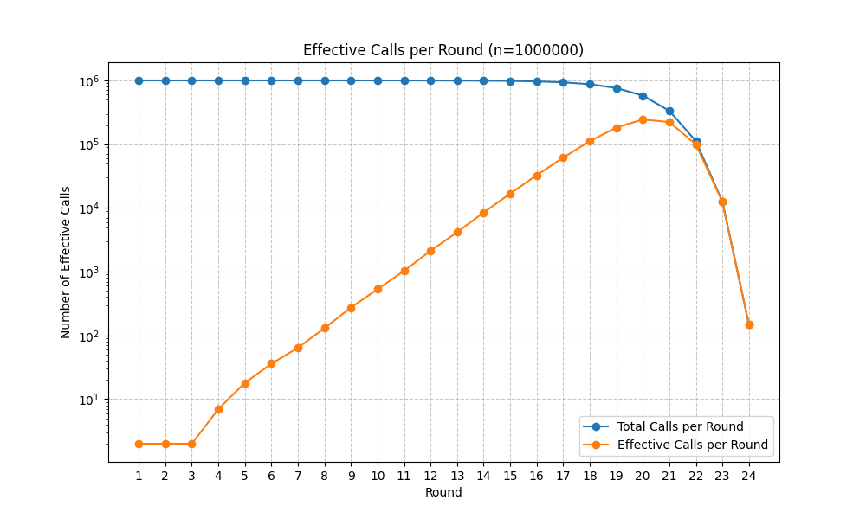
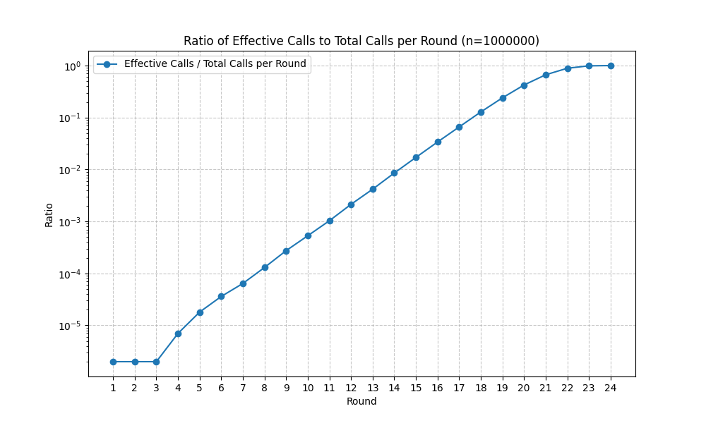
Effective calls (pull) in a sample run

Slide 17
Randomized Algorithm for Rumor Spread
Push Algorithm{
For round t = 1, 2, ..., T do:{
Input: I_{t} (set of informed nodes)
Output: I_{t+1} (updated set of informed nodes)
I_{new} ← ∅;
For all u ∈ I_{t} do
v ← Node chosen randomly uniformly from V;
if v ∈ U_{t} then:
I_{new} ← I_{new} ∪ {v};
I_{t+1} ← I_{t} ∪ I_{new};
return I_{t+1};
}
}
Pull Algorithm{
For round t = 1, 2, ..., T do:{
Input: I_{t} , U_{t}(set of informed and uninformed nodes)
Output: I_{t+1} , U_{t+1}(updated sets)
I_{new} ← ∅;
For all u ∈ U_{t} do
v ← Node chosen randomly uniformly from V;
if v ∈ I_{t} then:
I_{new} ← I_{new} ∪ {u};
I_{t+1} ← I_{t} ∪ I_{new};
U_{t+1} ← I_{t+1}’ ;
return I_{t+1} , U_{t+1} ;
}
}

Slide 18
Improved Algorithm

Slide 19
Improved Algorithm
Idea : Building on the simple push and pull strategies, we now combine the two.
Push & Pull Strategy:
In the improved approach, both push and pull operations are performed simultaneously:
• Each informed player pushes the rumor to a randomly chosen partner.
• Each uninformed player pulls the rumor by contacting a random partner.

Slide 20
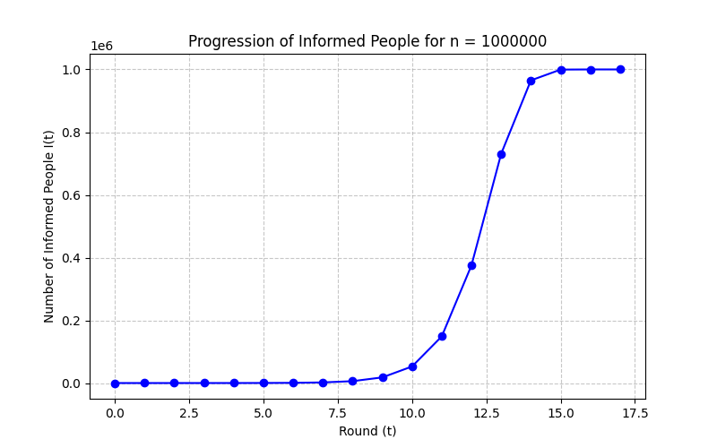
Push&Pull algorithm sample progression

Slide 21
Improved Algorithm
Push&Pull Algorithm{
Input: I_{t} , U_{t} (sets of informed and uninformed nodes)
Output: I_{t+1} (updated set of informed nodes)
I_{new} ← ∅;
NodesToInform ← ∅;
▷ Track who receives rumor this round
For all node u ∈ V do:
v ← Choose a node uniformly at random from V
▷ Node u sends 1 message
if u ∈ I_{t} then:
▷ Push Action
NodesToInform ← NodesToInform ∪ {v}
Else:
▷ u ∈ U_{t}, Pull Action
if v ∈ It then:
NodesToInform ← NodesToInform ∪ {u}
For all node w ∈ NodesToInform do:
if w ∈ U then:
I_{new} ← I_{new} ∪ {w};
I _{t+1} ← I_{t} ∪ I_{new} ;
return I_{t+1};
}

Slide 22
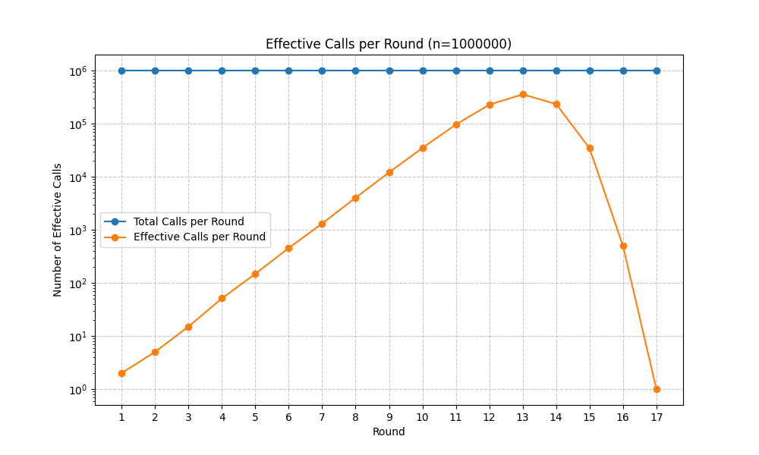
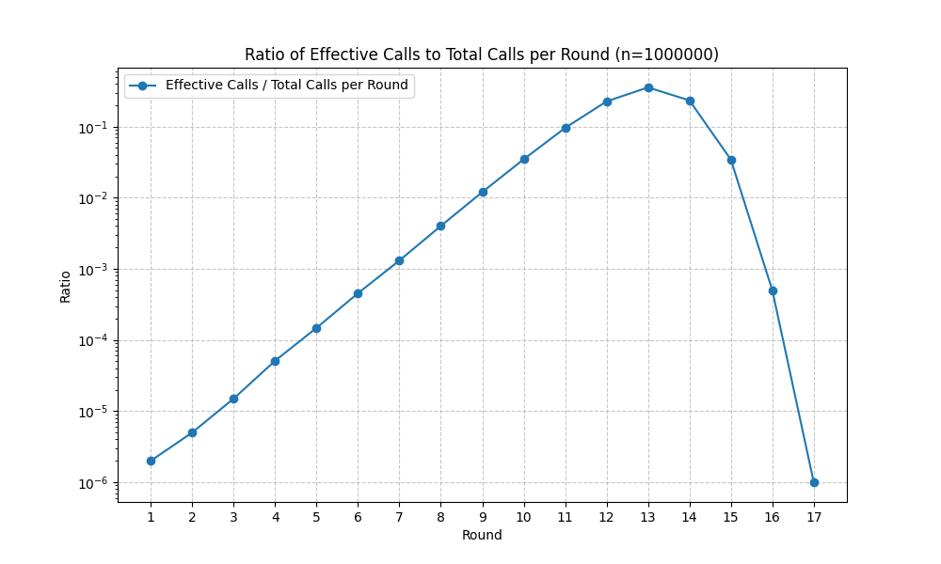
Effective calls Push&Pull in a sample run

Slide 23
Time and Message Complexity Analysis

Slide 24
Theorem 1 (Push Time Complexity):
The Push algorithm terminates in O(log n) rounds w.h.p.
Proof: We divide the process into two phases:
Phase 1 (Exponential Growth): i_{t} < n/2
Goal: Show i_{t} reaches n/2 in O(log n) rounds w.h.p.
From Lemma 1, E[i_{t+1}|I_{t}] ≈ 2i_{t}
As long as i_{t} ≤ n/2, E[i_{t+1}|I_{t}] ≥ 2i_{t} − i_{t}/2 = 1.5i_{t}.
The expected number grows by a constant factor >1.
Therefore, i_{t} grows exponentially in each round w.h.p.
Starting from i₀ = 1, reaching i_{t} = Ω(n) (e.g., n/2) takes O(log n) rounds w.h.p.

Slide 25
Theorem 1 (Push Time Complexity):
The Push algorithm terminates in O(log n) rounds w.h.p.
Proof:
Phase 2 (Convergence ): i_{t} ≥ n/2, so u_{t} ≤ n/2
Goal: Show u_{t} goes from ≤ n/2 to 0 in O(log n) rounds w.h.p.
For an uninformed node v, the probability it remains uninformed is:
P(stay) = (1−1/n​)​^{it}
Since i_{t} ≥ n/2,
P(stay) < (1−1/n​)^{0.5n} ≈ e^{-0.5} < 0.61
Result: No. of uninformed nodes decreases by at least a constant factor each round. Hence, convergence (i.e. u_{t} =0) also takes O(log n) rounds.
Hence, both phases combined also takes O(log n) rounds w.h.p.

Slide 26
Theorem 2 (Pull Time Complexity):
The Pull algorithm also terminates in O(log n) rounds w.h.p.
Proof: We divide the process into two phases:
Phase 1 (Initial Growth): i_{t} < n/2
Goal: Show i_{t} reaches Ω(n) (i.e. n/2) in O(log n) rounds w.h.p.
An uninformed node v becomes informed if it pulls from an informed node.
Pr[v gets informed at time t]= i_{t} /n
Expected new informed:
E[new ∣ I_{t} ]= u_{t} ⋅ i_{t} /n =(n−i_{t})⋅ i_{t} /n
Hence the expected size of the informed set evolves as:
E[ i_{t+1} ∣ I_{t} ] = i_{t} +(n−i_{t})⋅ i_{t} /n = 2i_{t}- i_{t} /n
This is the same expression as for the Push algorithm.
By standard Chernoff bounds i_{t} reaches Ω(n) in O(log n) rounds w.h.p.
2

Slide 27
Theorem 2 (Pull Time Complexity):
The Pull algorithm also terminates in O(log n) rounds w.h.p.
Proof:
Phase 2 (Fast Convergence) : i_{t} ≥ n/2, so u_{t} ≤ n/2
Goal: Show u_{t} goes from ≤ n/2 to 0 in O(log n) rounds w.h.p.
When i_{t} ≥ n/2 , each uninformed node v ∈ U_{t} has:
Pr [v informed at time t ] = i_{t}/n > 0.5
Thus each round at least half of the still-uninformed nodes get informed:
E[ u_{t+1} | U_{t} ] ≥ i_{t}/2
Again using Chernoff arguments, u_{t} drops by a constant factor each round and hits 0 after O(log n) steps w.h.p.
(In fact, We can achieve even tighter bound O(log log n) for this phase using Lemma 2)
Hence, Total time = O(log n) + O(log n) = O(log n) w.h.p.

Slide 28
Theorem 3 (Push & Pull Time Complexity):
The Push & Pull algorithm also terminates in O(log n) rounds w.h.p.
Proof: We divide the process into two phases:
Phase 1 (Initial Growth): i_{t} < n/2
An uninformed node v becomes informed if:
Push: An informed node decides to push to v, OR
Pull: v decides to pull from an informed node.
Pr[v gets informed] ≥ max ( Pr[Push] , Pr[Pull] ) ≥ i_{t} /n
As in “Push” (or “Pull” ), the informed nodes grows by a constant factor each round ​
This phase reaches i_{t} ≈ n/2​ in O(log⁡n) rounds w.h.p

Slide 29
Theorem 3 (Push & Pull Time Complexity):
The Push & Pull algorithm also terminates in O(log n) rounds w.h.p.
Proof: We divide the process into two phases:
Phase 2 (Fast Convergence): i_{t} ≥ n/2 , i.e. , u_{t} ≤ n/2
Once at least half the nodes are informed,
each uninformed node has a probability of over 1/2 of being informed per round
Thus u_{t} drops by at least a factor of 2 per round.
By concentration arguments,
u_{t} ​-> 0 in O(log n) rounds w.h.p.
Hence, Push-Pull total time=O(logn) w.h.p.​

Slide 30
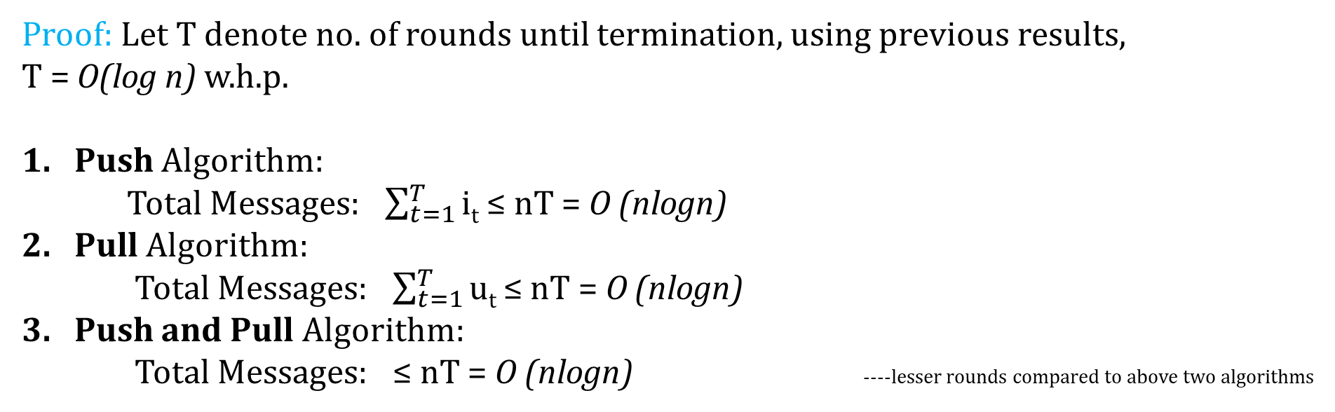
Theorem 4 (Message Complexity):
The Push, Pull, and Push-Pull algorithms use O(n logn) messages in total w.h.p.
Proof: Let T denote no. of rounds until termination, using previous results,
T = O(log n) w.h.p.
Push Algorithm:
Total Messages: $\sum_{t=1}^{T}{\text{i}\text{t}}$ ≤ nT = O (nlogn)
Pull Algorithm:
Total Messages: $\sum_{t=1}^{T}{\text{u}\text{t}}$ ≤ nT = O (nlogn)
Push and Pull Algorithm:
Total Messages: ≤ nT = O (nlogn) ----lesser rounds compared to above two algorithms

Slide 31
Experimental Results

Slide 32
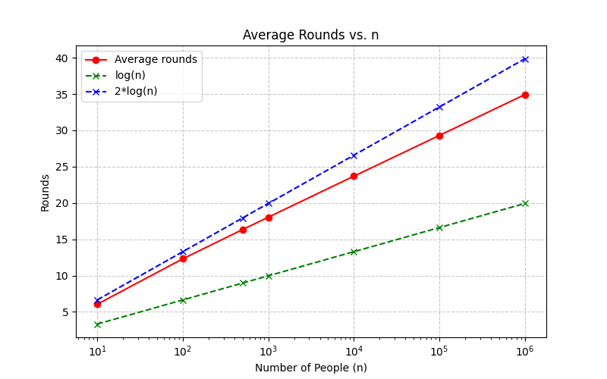
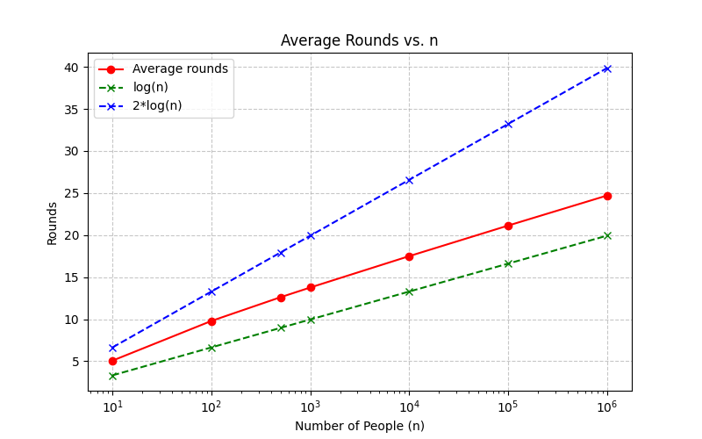
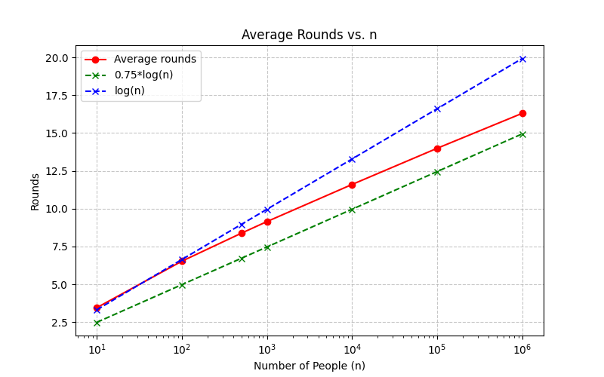
Average Rounds taken over 10⁵ runs
(Push)
(Pull)
(Push&Pull)
This results confirms the theoretical bound of O(logn) rounds
for these algorithms
X-axis: log scale
Y-axis: linear scale

Slide 33
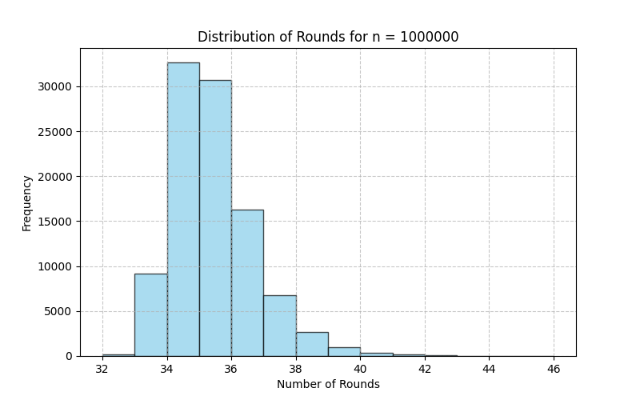
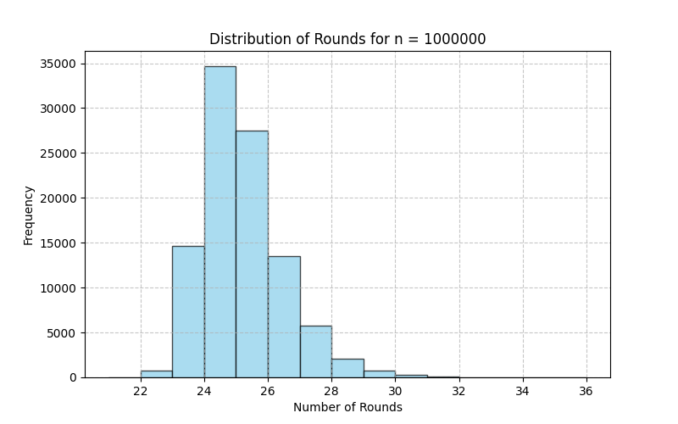
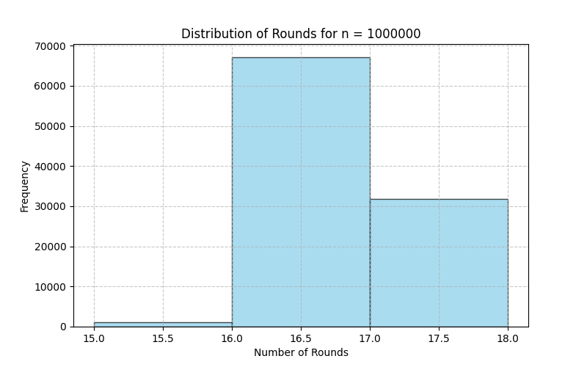
Distribution of Rounds taken over 10⁵ runs (for n= 10⁶)
(Push)
(Pull)
(Push&Pull)
These results confirms that these algorithms take O(logn) rounds
with high probability
X-axis: linear scale
Y-axis: linear scale

Slide 34
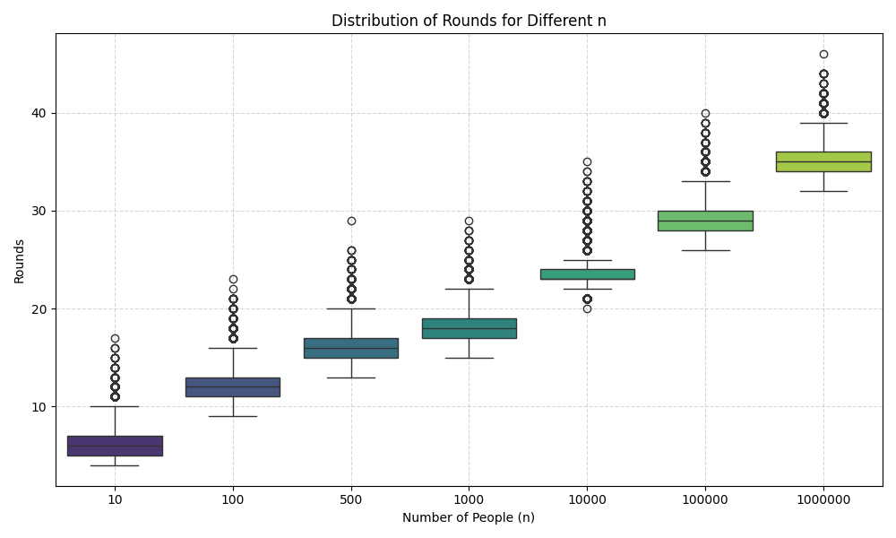
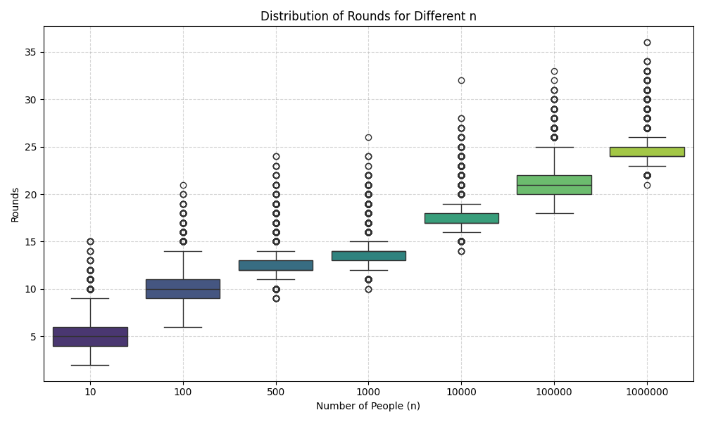
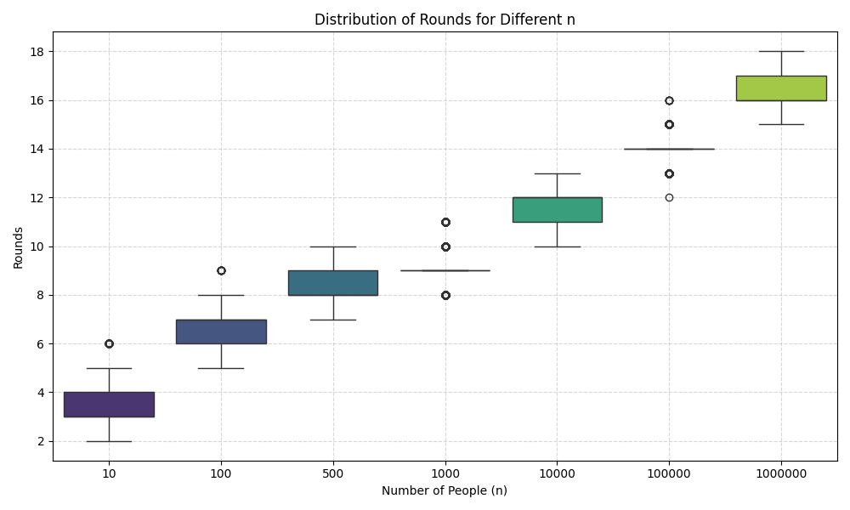
Distribution of Rounds taken over 10⁵ runs
(Push)
(Pull)
(Push&Pull)
These results confirms that these algorithms take O(logn) rounds
with high probability
X-axis: log scale
Y-axis: linear scale

Slide 35
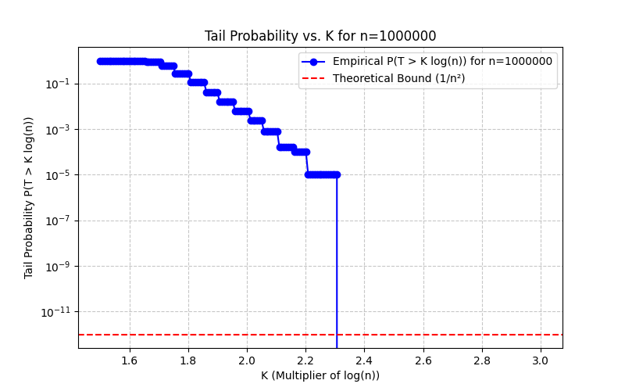
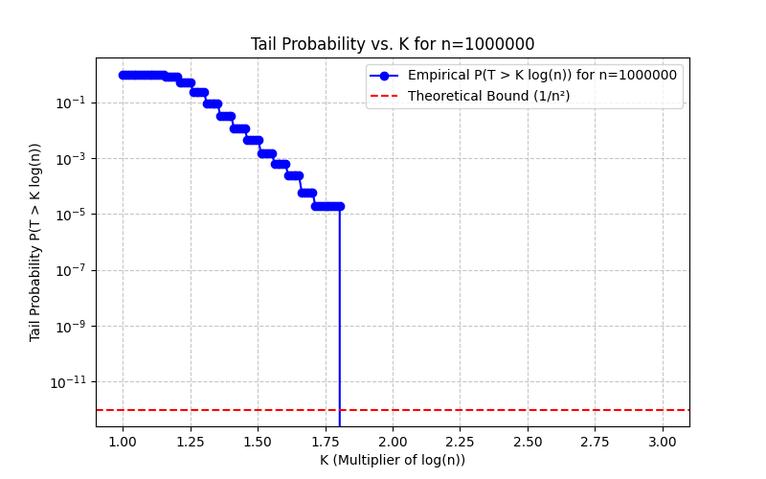
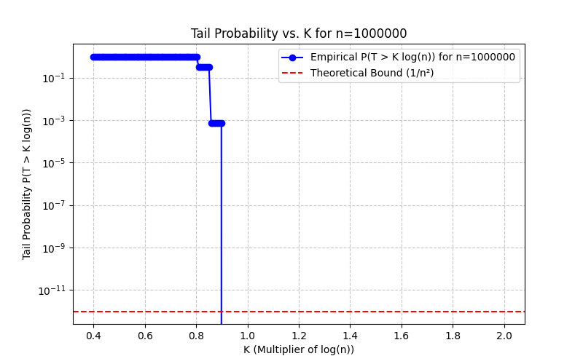
Deviation from the bound of O(logn), (for n= 10⁶)
(Push)
(Pull)
(Push&Pull)
These results confirms that these algorithms take O(logn) rounds
with high probability
X-axis: linear scale
Y-axis: log scale

Slide 36
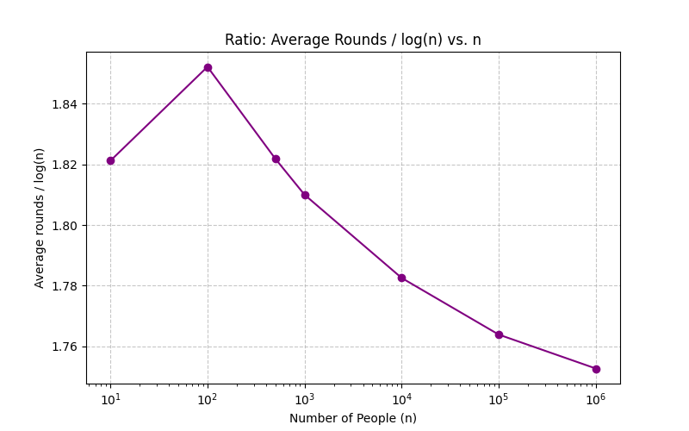
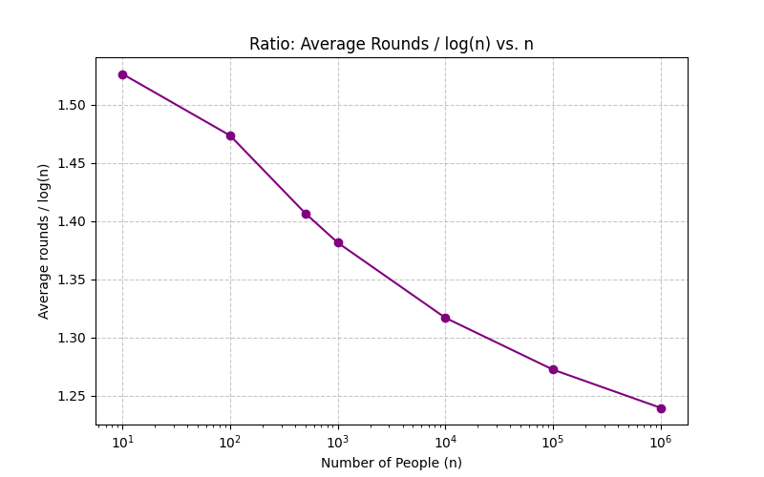
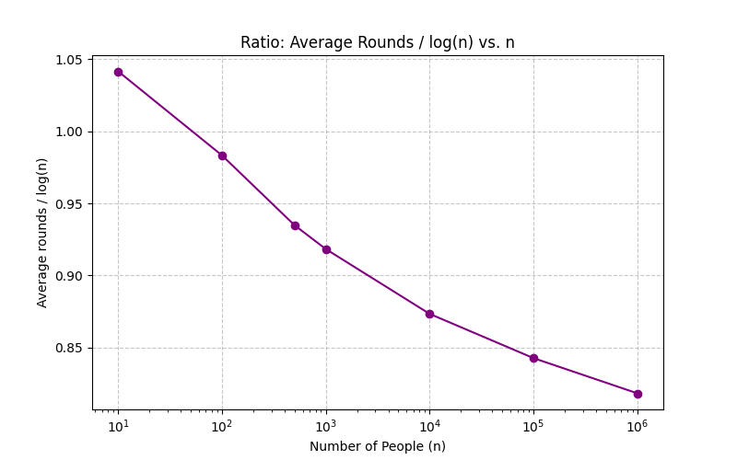
Variation of Ratio = Average Rounds/ logn
(Push)
(Pull)
(Push&Pull)
These results confirms that these algorithms take O(logn) rounds
with high probability
X-axis: log scale
Y-axis: linear scale

Slide 37
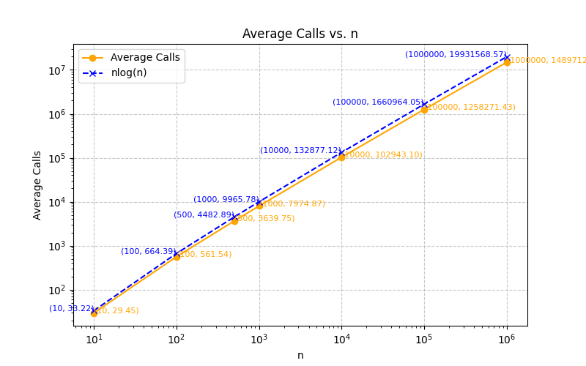
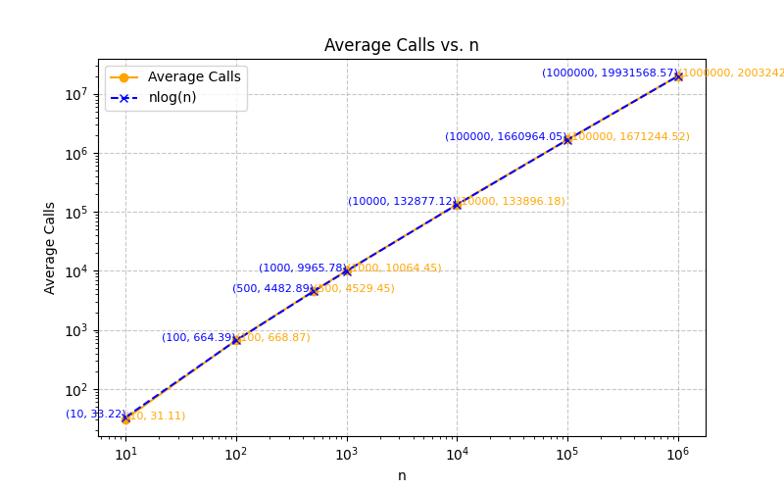
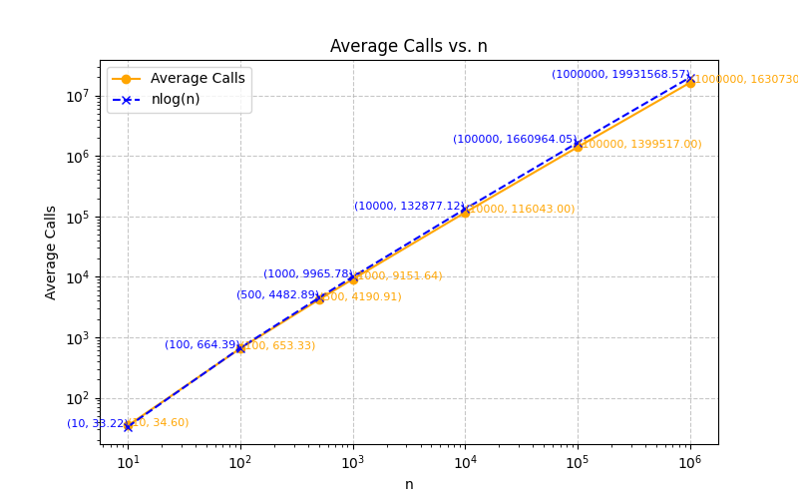
Avg. total messages/calls made, over 10⁵ runs
(Push)
(Pull)
(Push&Pull)
These results confirms the theoretical bound of O(nlogn) message transmissions for these algorithms
X-axis: log scale
Y-axis: log scale

Slide 38
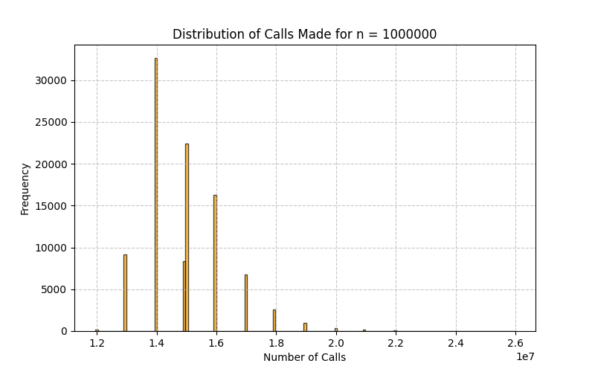
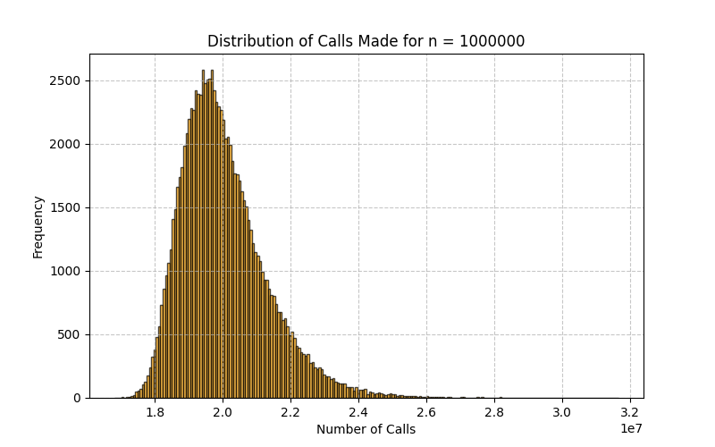
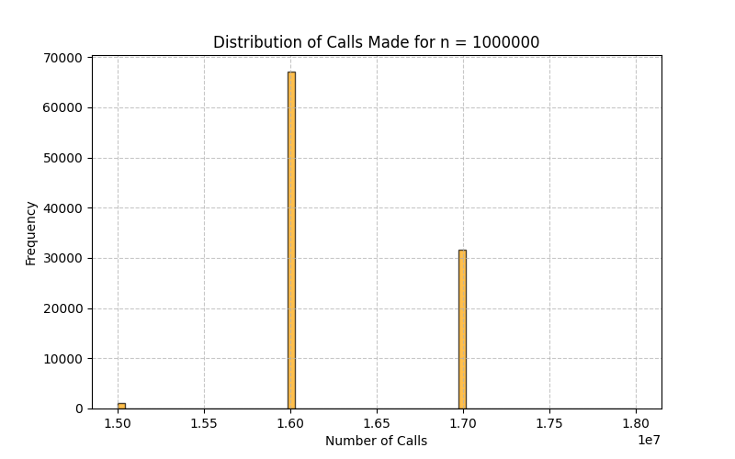
Distribution of total calls made, over 10⁵ runs
(Push)
(Pull)
(Push&Pull)
These results confirms that these algorithms takes O(nlogn) message transmissions with high probability
X-axis: linear scale
Y-axis: linear scale

Slide 39
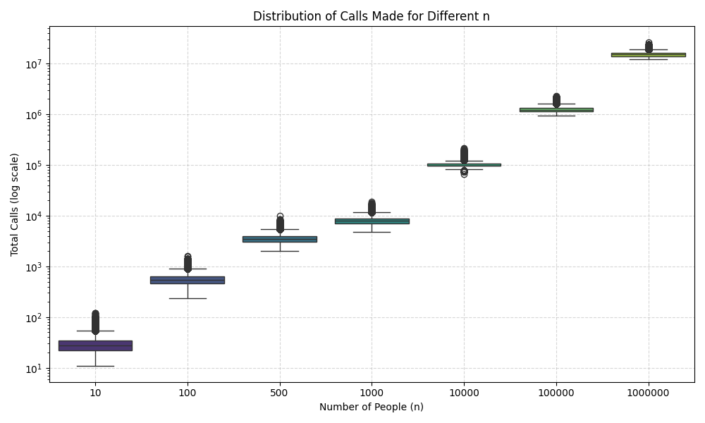
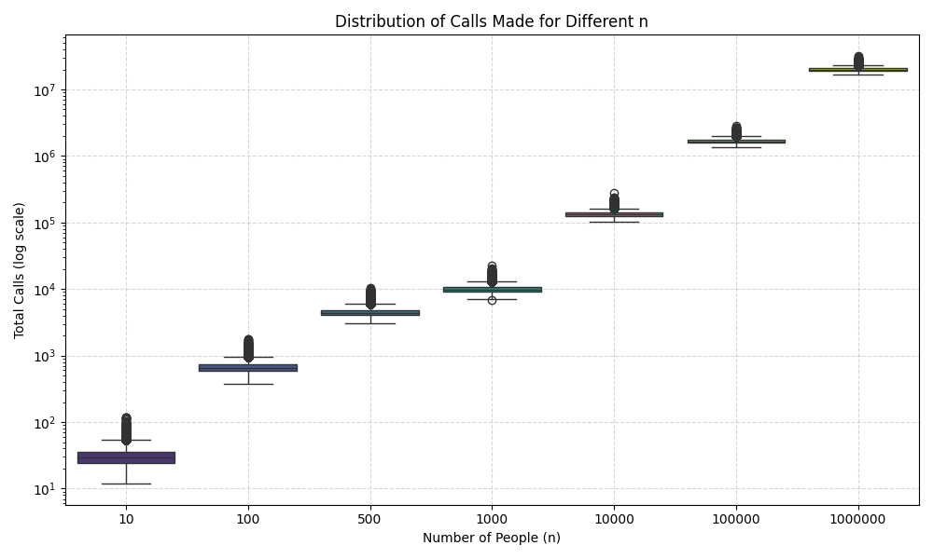
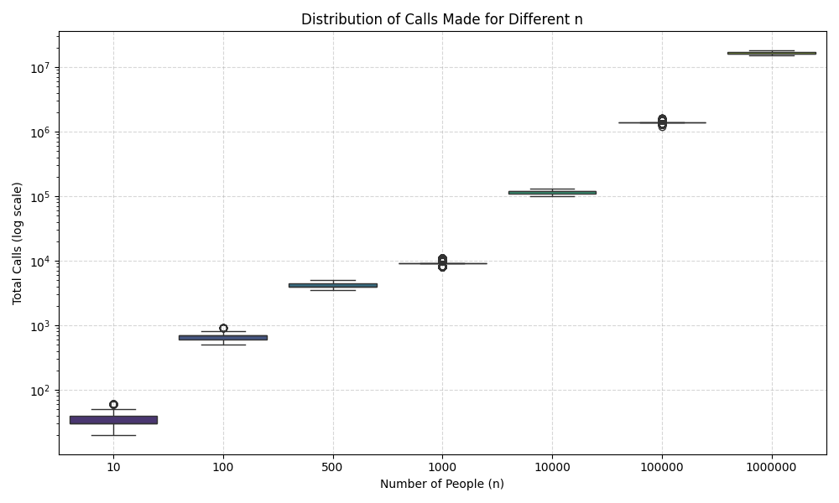
Distribution of #total calls made, over 10⁵ runs
(Push)
(Pull)
(Push&Pull)
These results confirms that these algorithms takes O(nlogn) message transmissions with high probability
X-axis: log scale
Y-axis: log scale

Slide 40




Thank you

